Slide 1


Introduction to
Robotic Process Automation
Online Shopping Comparison Automation
Register No : 220701090
Name : Helina Sergius D
Guide Name : Mrs.J.Jinu Sophia
Designation and Department : Assistant Professor(SG)

Slide 2
Abstract
The Online Shopping Comparison Bot is designed to automate the process of comparing product details from e-commerce platforms like Amazon and Flipkart. Using UiPath, a leading Robotic Process Automation (RPA) tool, the bot extracts key product information such as name, price, and ratings based on user input. The workflow includes launching the websites, searching for the specified product, and retrieving structured data in a systematic format. This automation eliminates the need for manual browsing, saves time, and ensures accurate comparisons by handling dynamic web page structures effectively. The project is an efficient solution for e-commerce analytics and supports informed decision-making in online shopping.

Slide 3
Need for the Proposed System
The proposed system is essential for addressing the challenges of manual data extraction from e-commerce platforms like Flipkart, which is time-consuming, error-prone, and inefficient, especially when dealing with large volumes of data or frequent updates. Businesses require an automated solution to accurately extract product information such as names, prices, ratings for purposes like market analysis and competitor benchmarking. By utilizing UiPath for robotic process automation (RPA), the system ensures fast, consistent, and accurate data retrieval while reducing operational costs and enabling teams to focus on strategic tasks. Its adaptability to dynamic web structures further enhances its relevance and reliability in the rapidly evolving e-commerce landscape.

Slide 4
Advantages of the Proposed System
The proposed system offers several advantages, particularly in enhancing the efficiency and accuracy of product data extraction from e-commerce platforms like Amazon and Flipkart. By automating the process of searching for products, retrieving detailed information, and displaying results for comparison, the system significantly reduces manual effort and the time required to gather product data. It ensures consistent and accurate extraction of key attributes such as product name, price, and rating, which can be used for data analysis or decision-making. Additionally, the automation is scalable and can be adapted to handle multiple product queries, making it ideal for large-scale e-commerce analytics. The system can also be extended with error handling and dynamic selectors, ensuring robustness even in the face of changing website structures. Moreover, by allowing parallel processing and comparing data across multiple platforms, it offers enhanced decision support for businesses and consumers looking to make informed purchasing choices.

Slide 5
Literature Survey
Paper 1
https://www.researchgate.net/profile/David-Andrade-22/publication/349468774_Challenges_of_Automated_Software_Testing_with_Robotic_Process_Automation_RPA_-_A_Comparative_Analysis_of_UiPath_and_Automation_Anywhere/links/635452d68d4484154a23f8aa/Challenges-of-Automated-Software-Testing-with-Robotic-Process-Automation-RPA-A-Comparative-Analysis-of-UiPath-and-Automation-Anywhere.pdf?origin=journalDetail&_tp=eyJwYWdlIjoiam91cm5hbERldGFpbCJ9
Advantages
Increased Efficiency: Bots can perform repetitive tasks 24/7 without breaks, allowing faster test execution and results compared to human testers
Enhanced Accuracy: Automation reduces human errors, improving the reliability of test results, especially for tasks like regression testing
Disadvantages
Limited Scope for Complex Testing: RPA struggles with tasks requiring intuition or understanding of business logic, which often rely on human testers
Maintenance Challenges: Upgrading and maintaining automation tools can be difficult and costly, especially if existing scripts are not forward-compatible​

Slide 6
Literature Survey
Paper 2
https://citeseerx.ist.psu.edu/document?repid=rep1&type=pdf&doi=85234fad821de5dc764aa8652edd37d07705557c
Advantages
Efficiency in Comparison Shopping: The system automates price comparisons, significantly reducing the time users spend manually searching for product deals across multiple websites.
Scalability and Adaptability: By integrating machine learning for automatic information extraction, the system can adapt to changes in website layouts, reducing the need for frequent manual code updates.
Disadvantages
Dependence on System Resources: The performance is heavily dependent on system capabilities, with efficiency gains plateauing as the number of agents increases due to limited hardware resources.
Maintenance Requirements: Frequent changes in target website structures necessitate periodic retraining or updating of the system to maintain its functionality.

Slide 7
Main Objective
The main objective of this project is to automate the process of extracting and comparing product details, such as name, price, rating, and image, from multiple e-commerce platforms (Amazon and Flipkart) using UiPath. This automation aims to streamline the collection of relevant product information, minimize manual effort, and provide quick and accurate insights for decision-making, whether for consumers comparing products or businesses conducting e-commerce analytics. By leveraging robotic process automation (RPA), the project seeks to enhance efficiency, accuracy, and scalability in gathering and analyzing product data from online marketplaces.

Slide 8
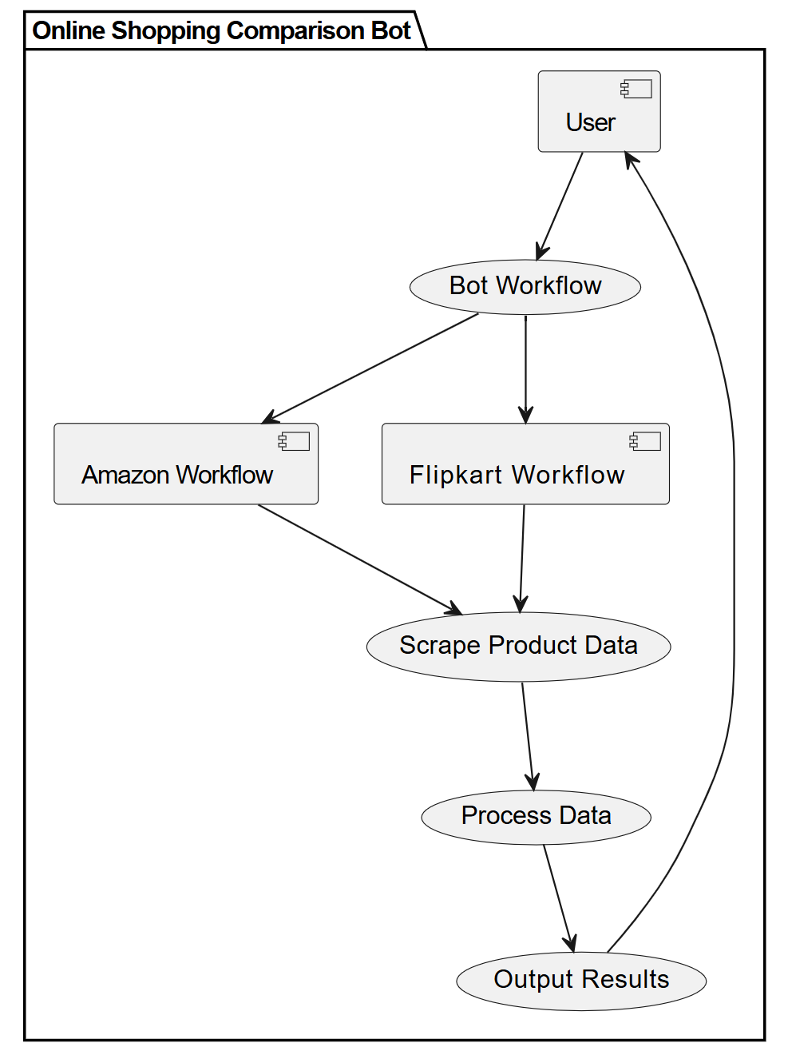
Architecture

Slide 9
System Requirements
HARDWARE
Processor: A multi-core processor (Intel i5 or higher recommended).
RAM: 8GB RAM or more.
Storage: 10GB of free disk space for installing UiPath Studio and related software
Display: A screen resolution of 1920x1080 or higher.
SOFTWARE
Operating System: Windows 10 or higher (64-bit recommended).
UiPath Studio: The latest version of UiPath Studio, which is the RPA development environment.
Web Browser: Microsoft Edge (or any supported browser such as Chrome or Firefox) for automating the web interactions.
UiPath Extensions: Browser extensions for UiPath to enable web automation in Microsoft Edge or other browsers.

Slide 10
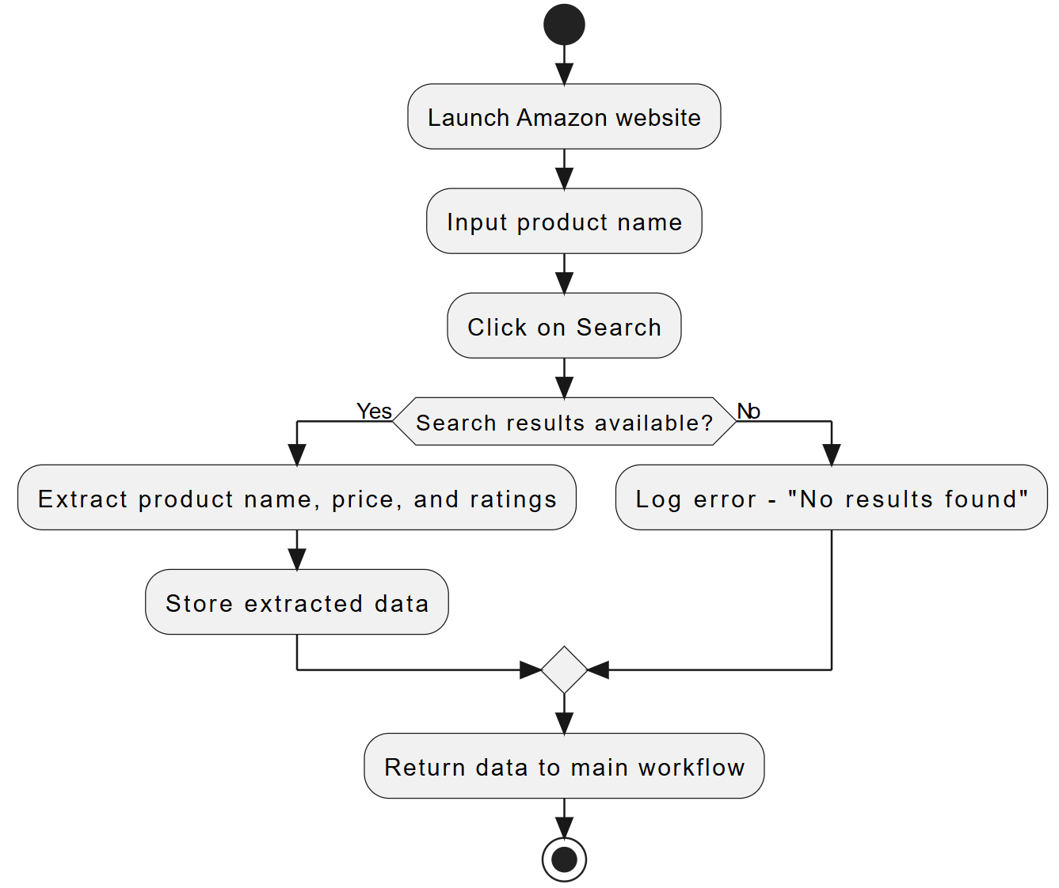
Functional Description
SEQUENCE - SYSTEM FLOW DIAGRAM
The Amazon workflow begins by launching the Amazon website.
If Yes: Extracts product details (name, price, ratings) and stores them.
If No: Logs an error indicating no results were found.
The product name is entered, and the search is triggered.

Slide 11
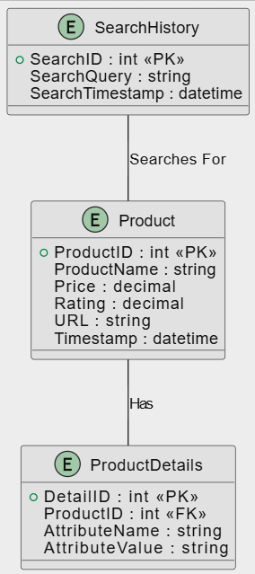
Table Design
ERD

Slide 12
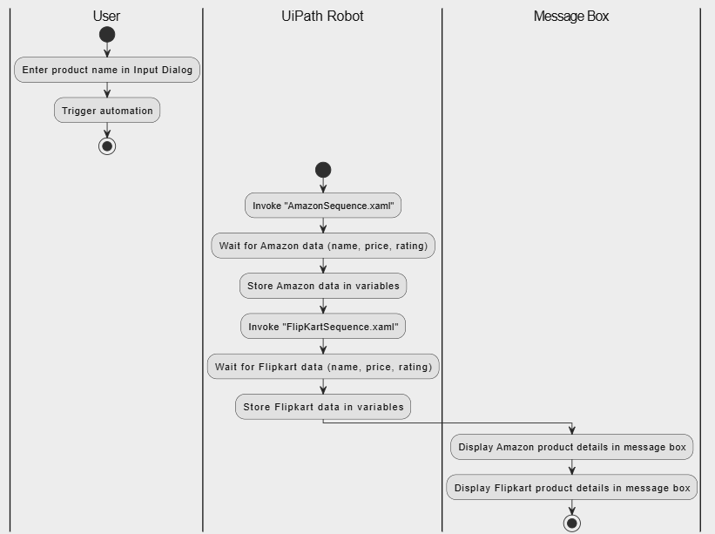
Process Design

Slide 13
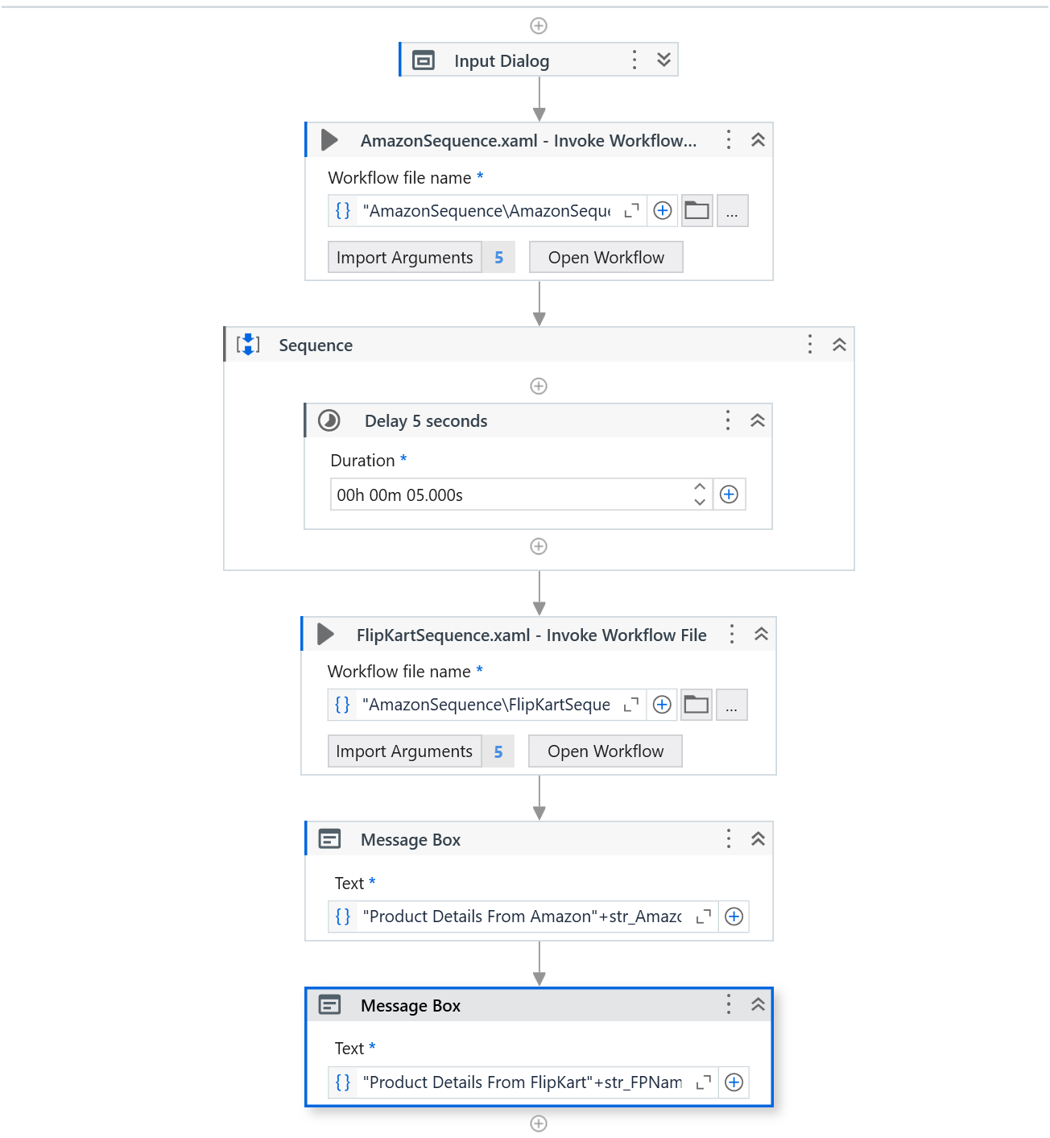
Process Design
Main Sequence

Slide 14
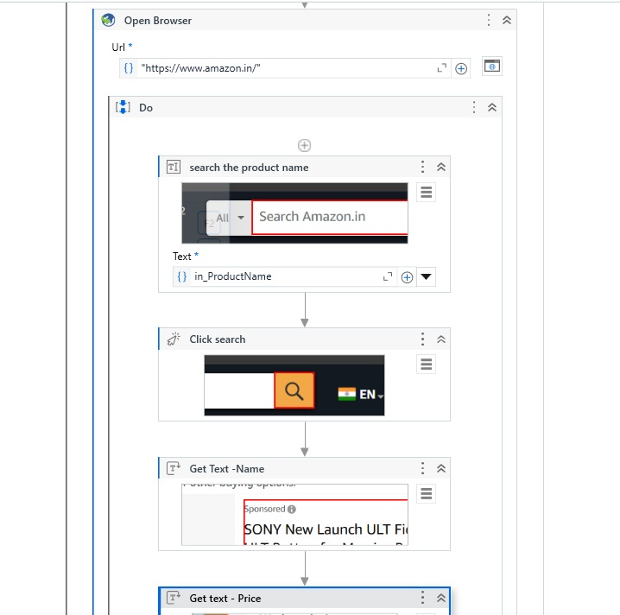
Process Design
Amazon Sequence

Slide 15
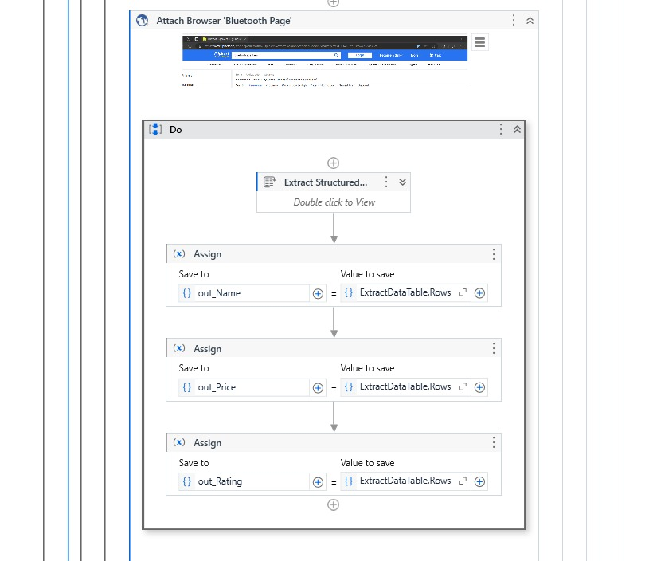
Process Design
FlipKart Sequence

Slide 16
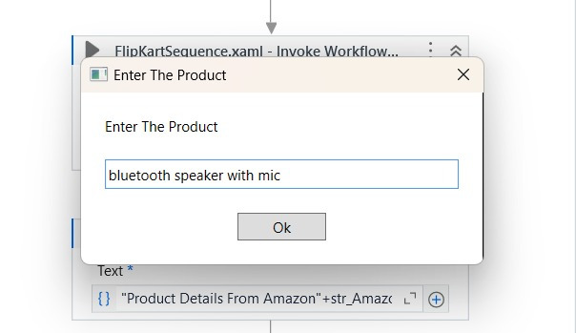
Implementation
The bot will get the product name in the input dialog box

Slide 17
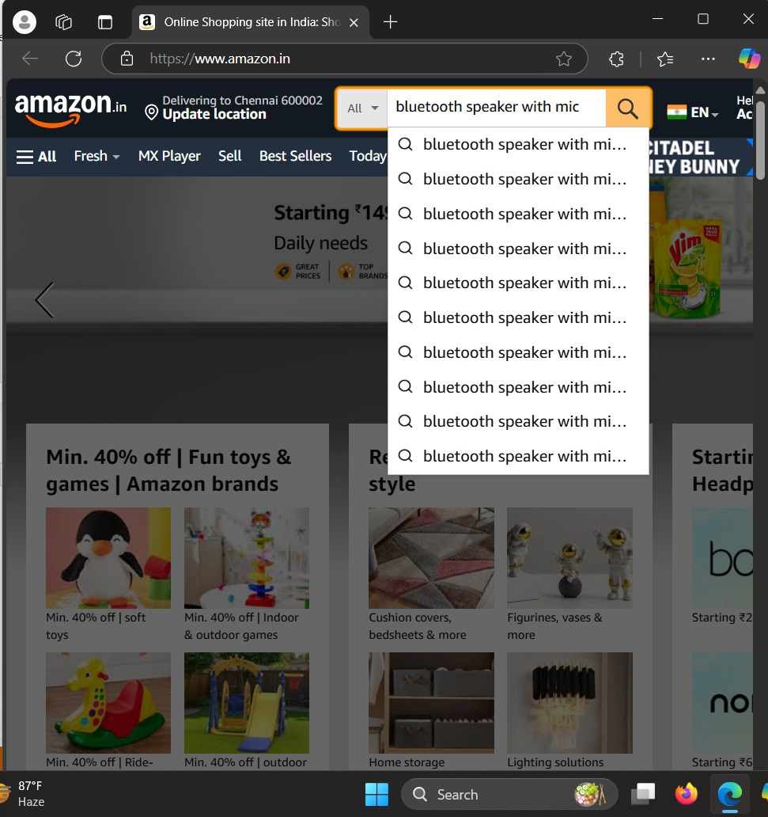
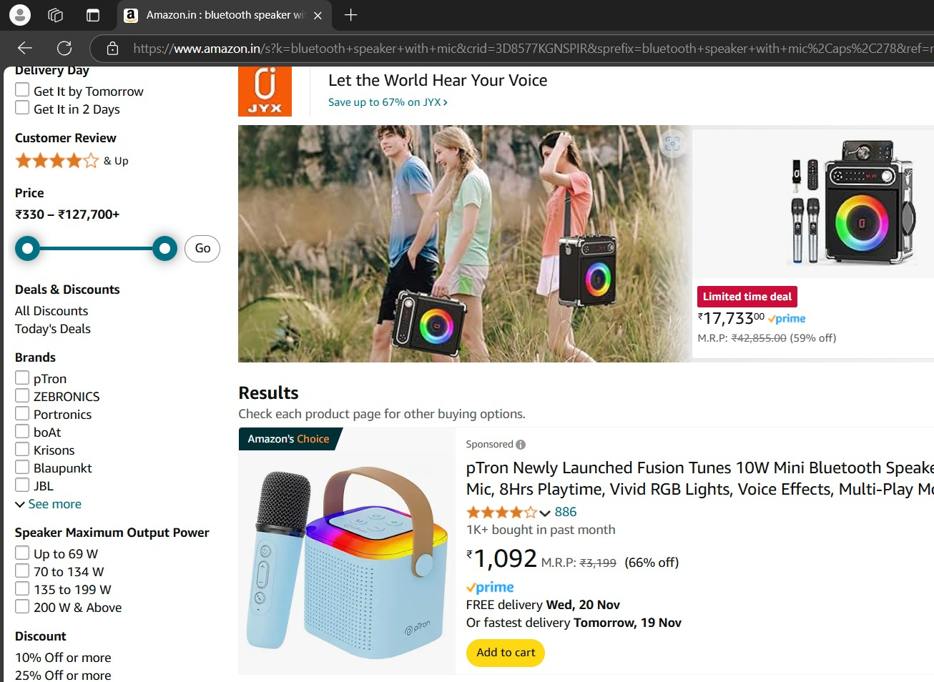
Implementation
The bot will search for the product in amazon and then fetch data from the product

Slide 18
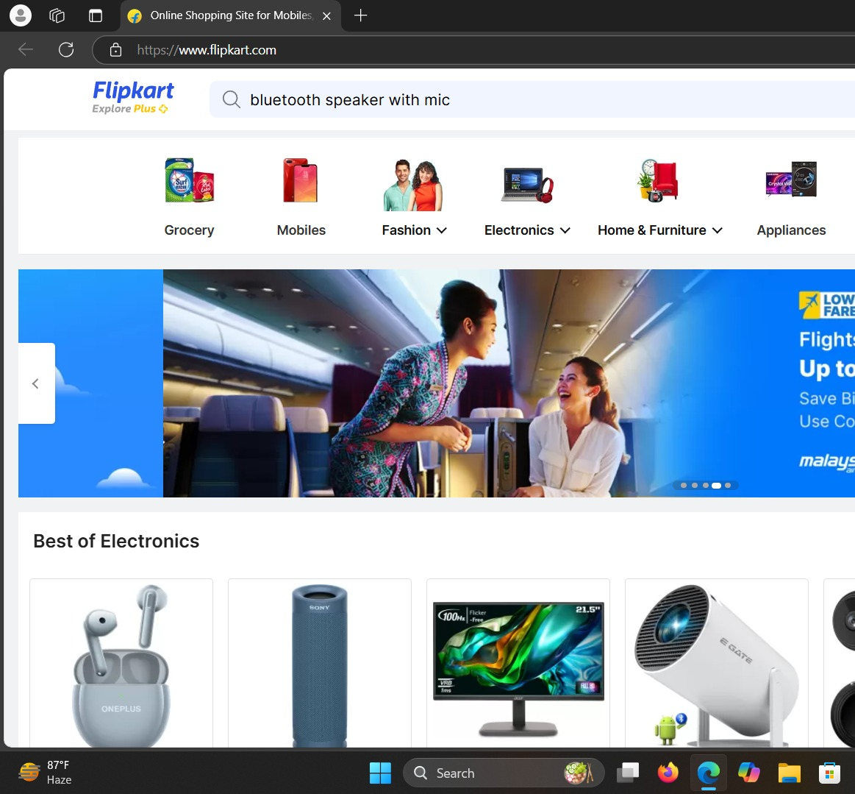
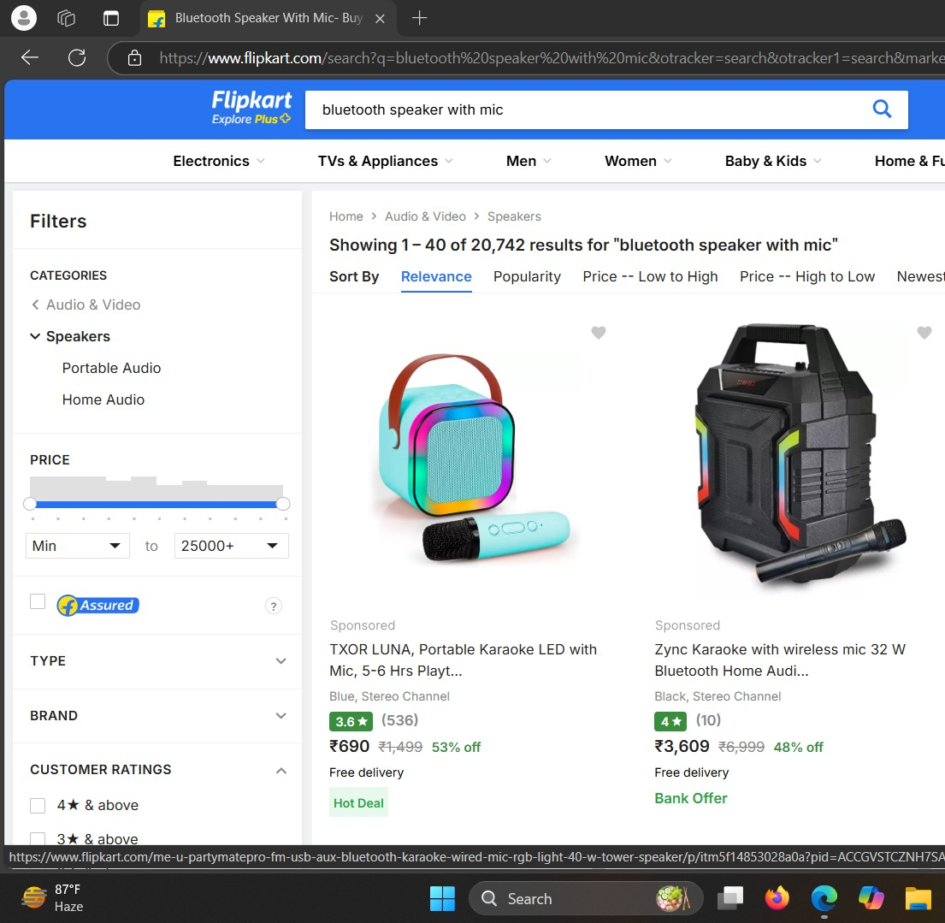
Implementation
The bot will search for the product in flipkart and then fetch the data from the product

Slide 19
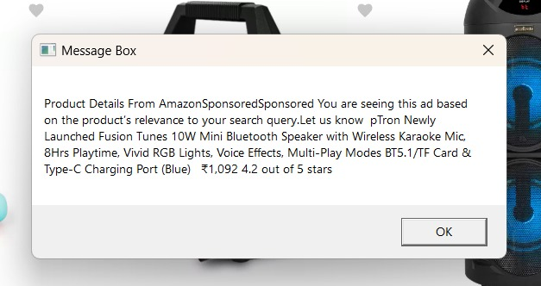
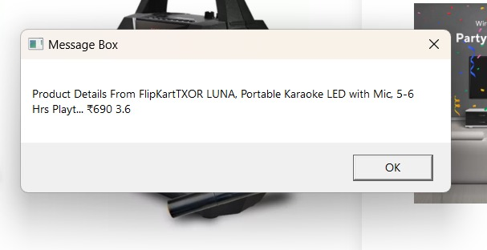
Outcome
The bot will show the product details from FlipKart and Amazon website

Slide 20
Testing
Description: Test this automation, verify the handling of various product inputs, including invalid or empty ones. Check if the automation navigates Flipkart accurately and performs searches seamlessly.
Validate the extracted data (name, price, ratings) against the website to ensure accuracy. Test edge cases like no results, multiple pages, or dynamic webpage changes. Confirm that output data is saved correctly in the desired format, such as Excel or CSV
Lastly, assess performance with multiple searches to ensure reliability and efficiency

Slide 21
Conclusions
Description:In conclusion, this UiPath automation project successfully streamlines the process of extracting product details from Flipkart, making it efficient and scalable for e-commerce data analysis.
By leveraging UiPath's powerful features like Type Into, Click, and Data Scraping, the automation ensures accurate and structured data extraction, even from dynamic webpages.
The system is designed to handle various input scenarios, including edge cases, and outputs the data in a user-friendly format for further analysis. Overall, this solution enhances decision-making in e-commerce by providing reliable and actionable insights.

Slide 22
Future Enhancement
Description 1:Future enhancements for this project could focus on expanding its capabilities and improving efficiency. One possible enhancement is integrating the automation with multiple e-commerce platforms, such as Amazon or Snapdeal, to compare product details across different sites in real-time. Additionally, implementing AI-driven techniques could enhance the data extraction process, allowing the automation to adapt to significant changes in website layout or structure.
Description 2: Adding advanced error handling and notifications would improve the reliability of the workflow. The inclusion of data visualization tools, such as dashboards or graphs, could provide real-time insights, further enhancing decision-making. Lastly, incorporating a scheduling feature would allow automated, periodic data collection for ongoing analysis.

Slide 23
References
Kuppusamy, Palanivel & Joseph K, Suresh. (2020) Robotic ProcessAutomation to product comparison. 3775.
Patil, Dr & Mane, Vinod & Patil, Dr. (2019). Innovation Online shopping bots for e-commerce in Automation (Rpa). International Journal of Innovative Technology and Exploring Engineering. 8. 3757-3760. 10.35940/ijitee.K2148.0981119.
Elkhatat, A.M., Elsaid, K. & Almeer, S. Evaluating the efficacy of AI content detection tools in differentiating between human and AIgenerated text. Int J Educ Integr 19, 17 (2023). https://doi.org/10.1007/s40979-023-00140-5
H. Alamleh, A. A. S. AlQahtani and A. ElSaid, "Comparison Shopping System Using Multiple Agents and Auto-Extraction ," 2023 Systems and Information Engineering Design Symposium (SIEDS), Charlottesville, VA, USA, 2023, pp. 154-158, doi: 10.1109/SIEDS58326.2023.10137767.

Slide 24
Thank You
220701090
HELINA SERGIUS D
BE COMPUTER SCIENCE AND ENGINEERING

